Slide 1
Student Alcohol Consumption
How is alcohol consumption among students related to academic performance

Slide 2
INTRODUCTION

Slide 3
INTRODUCTION
The goal of the following work is to explore the relationship between alcohol consumption and academic performance of students in two secondary schools in Portugal.
The final objective will be predicting the end-term Math grade through the use of Machine Learning methodologies and to provide advice on school management on how to improve each student academic performance.

Slide 4
INTRODUCTION
In the Portuguese scholar system the grades are between 0 and 20 where 0-9 is Insufficient, 10-15 is Good, 16-20 is Excellent.
Their personal information was gathered through anonymous surveys.

Slide 5
DATASET VISUALIZATION

Slide 6
DATASET VISUALIZATION
school - student's school (binary: 'GP' - Gabriel Pereira or 'MS' - Mousinho da Silveira)
sex - student's sex (binary: 'F' - female or 'M' - male)
age - student's age (numeric: from 15 to 22)
address - student's home address type (binary: 'U' - urban or 'R' - rural)
famsize - family size (binary: 'LE3' - less or equal to 3 or 'GT3' - greater than 3)
Pstatus - parent's cohabitation status (binary: 'T' - living together or 'A' - apart)
Medu - mother's education (numeric: 0 - none, 1 - primary education (4th grade), 2 – 5th to 9th grade, 3 – secondary education or 4 – higher education)
Fedu - father's education (numeric: 0 - none, 1 - primary education (4th grade), 2 – 5th to 9th grade, 3 – secondary education or 4 – higher education)

Slide 7
DATASET VISUALIZATION
Mjob - mother's job (nominal: 'teacher', 'health' care related, civil 'services' (e.g. administrative or police), 'at_home' or 'other')
activities - extra-curricular activities (binary: yes or no)
nursery - attended nursery school (binary: yes or no)
higher - wants to take higher education (binary: yes or no)
internet - Internet access at home (binary: yes or no)
romantic - with a romantic relationship (binary: yes or no)
famrel - quality of family relationships (numeric: from 1 - very bad to 5 - excellent)
freetime - free time after school (numeric: from 1 - very low to 5 - very high)
goout - going out with friends (numeric: from 1 - very low to 5 - very high)

Slide 8
DATASET VISUALIZATION
Dalc - workday alcohol consumption (numeric: 1 - very low to 5 - very high)
Walc - weekend alcohol consumption (numeric: from 1 - very low to 5 - very high)
health - current health status (numeric: from 1 - very bad to 5 - very good)
absences - number of school absences (numeric: from 0 to 93)

Slide 9
DATASET VISUALIZATION
These grades are related with the course subject Math
G1 - first period grade (numeric: from 0 to 20)
G2 - second period grade (numeric: from 0 to 20)
G3 - final grade (numeric: from 0 to 20, output target)

Slide 10
PRELIMINARY ANALISYS

Slide 11
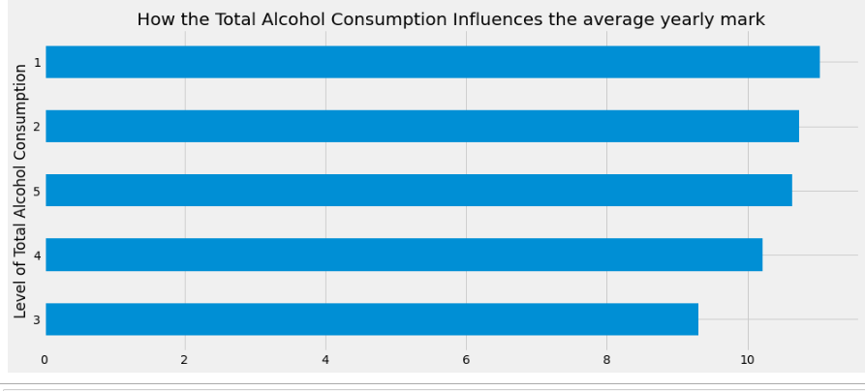
PRELIMINARY ANALISYS
Students with lower alcohol consumption tend to have a higher academic performance

Slide 12
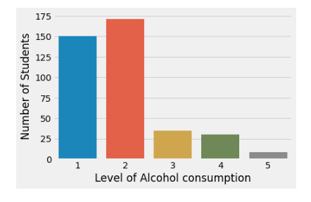
PRELIMINARY ANALISYS
As the dataset consists mostly of
students with low alcohol consumption
it is expected to train a model biased
toward this category.
This means the trained model will have a
low predictive accuracy when provided
with students with an extreme level of alcohol consumption

Slide 13
MACHINE LEARNING MODELS

Slide 14
MACHINE LEARNING MODELS
The trained model should be able to give an estimate of the final mark of a student according to his personal information.
The Machine Learning Models trained will be regressors.

Slide 15
MACHINE LEARNING MODELS
A regressor is supervised model which finds the relationship between known numerical values with the goal of predicting a numerical output.
In simpler words, it is a mathematical formula for calculating a number.

Slide 16
MACHINE LEARNING MODELS
A few regressors will be compared and combined with each others with the aim of obtaining the most accurate model.
The trained regressors will be:
Linear Regressor
Decision Tree Regressor
K Nearest Neighbours Regressor
Random Forest Regressor
XG Boost Regressor

Slide 17
MACHINE LEARNING MODELS STRENGTHS AND WEAKNESSES
LINEAR REGRESSOR: easy to interpret and train but prone to noise and overfitting
DECISION TREE REGRESSOR: easy to visualize, not influenced by outliers but prone overfitting
KNN REGRESSOR: simple and powerful but memory intensive
RANDOM FOREST REGRESSOR: fast, able to deal with unbalanced or missing data but it can’t predict beyond range of training data, prone to overfitting
XGBOOST: effective with large datasets but very sensitive to outliers

Slide 18
MACHINE LEARNING MODELS STRENGTHS AND WEAKNESSES
ENSEMBLE: a method which is a combination of other methods, it performs better than the best single method used in it but it can be used only with models of similar performances

Slide 19
MACHINE LEARNING MODELS EVALUATION
The models will be evaluated using the following scores:
R squared (coefficient of determination) is a statistical measure in a regression model that determines the proportion of variance in the dependent variable that can be explained by the independent variable.
It ranges from 0 to 1.
A reliable regression model has a value of R squared around 0,95

Slide 20
MACHINE LEARNING MODELS EVALUATION
MAE is the average of the absolute difference between the actual and predicted values
MSE is the average of the squared difference between the original and predicted values
RMSE is the square root of Mean Squared error. It measures the standard deviation of residuals.
The lower value of MAE, MSE, and RMSE implies higher accuracy of a regression model.

Slide 21
MACHINE LEARNING MODELS EVALUATION
The RMSE tells how well a regression model can predict the value of a response variable in absolute terms while R- Squared tells how well the predictor variables can explain the variation in the response variable.

Slide 22
MACHINE LEARNING MODELS CLUSTERING
K MEANS is an unsupervised method of partitioning n observations into k given clusters in which each observation belongs to the cluster with the distance from calculated centers or cluster centroids.
It is expected to partition the dataset into at least 3 groups of students:
Underachievers
Average achieving students
Exceptional students

Slide 23
MACHINE LEARNING MODELS CLUSTERING
Each group of students will have similar characteristics.
It is expected to link said features to academic performances

Slide 24
CONCLUSION

Slide 25
GENERAL THOUGHTS
As expected, all models have achieved low levels of R 2 squared: this has been caused by the nature of the data, characterised by high variability; this means the calculated models are still valid on average but they can’t make accurate prediction for marks.
Looking at the dataset, the models will be accurate estimating the academic performances of futures "average student «and will be unrealiable for "outstanding students"

Slide 26
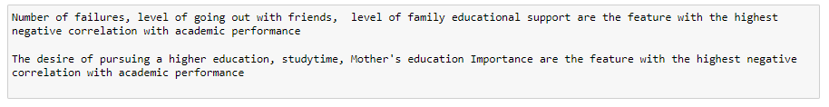
LINEAR REGRESSOR INSIGHT
Surprisingly, students with a high level of educational support from the family tend to have a lower academic performance.
As students with highly educated parents or those with high level of school educational support do not have this negative correlation we can assume there might be a need to provide an external aid to parents home tutoring.

Slide 27

DECISION TREE INSIGHT
As expected, among the most important
informations to estimate the future
academic performance of a student there
are number of failures and absences.
School educational support appears to be
particularly effective, and it could be
recommended to invest more resources into
additional school hours for selected students.

Slide 28
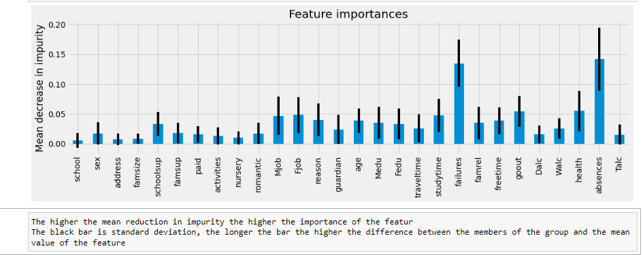
RANDOM FOREST INSIGHT
All features have a high degree of standard deviation.
Levels of health, going out with friends and study time are important factors in determining future academic performance and should be monitored

Slide 29
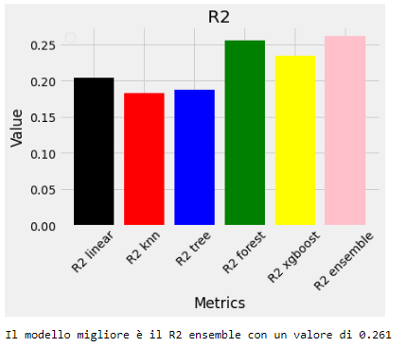
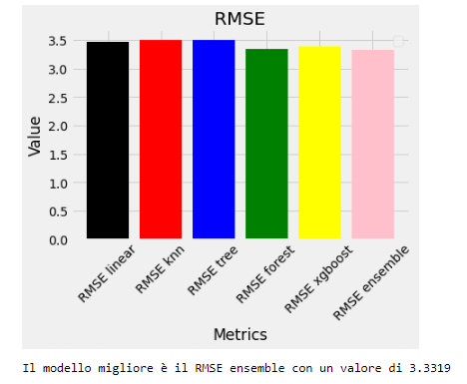
COMPARISON BETWEEN MODELS
Using an ensemble of all ML trained models appears to provide the most accuracy in making predictions about academic performances.

Slide 30
CLUSTERING
The model found 4 different groups of students:

Slide 31
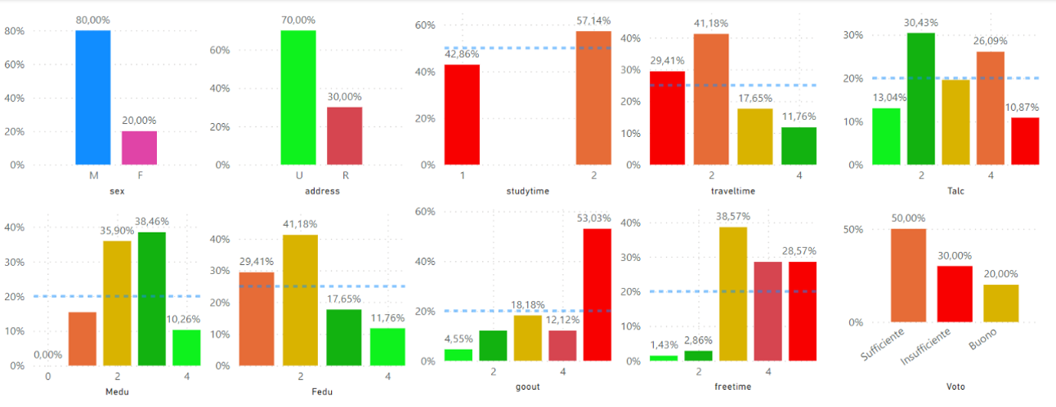
CLUSTERING
CLUSTER 01: " The boy from the suburbs "
Male, High travel time (far from school), low level parents education.

Slide 32
CLUSTERING
CLUSTER 01: " The boy from the suburbs "
High travel time (far from school), low level parents education.
High free time
Moderate to high alcohol consumption
Low to insufficient academic performance

Slide 33
CLUSTERING
CLUSTER 01: " The boy from the suburbs "
High travel time (far from school), low level parents education.
It is advised to involve the student in additional curricular activities at school, in order to increase the ratio between educational time and travel time and to provide the student with the academic guidance his parents cannot provide.
It is advised to invest in cafeterias, student housing and afternoon educational activities.

Slide 34
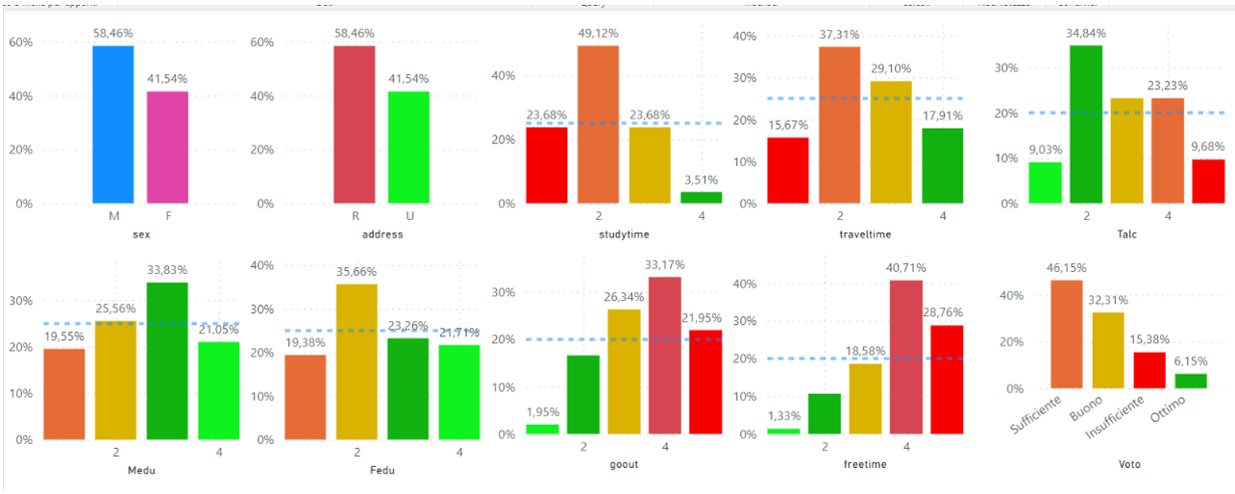
CLUSTERING
CLUSTER 02: " The average student "
High study time, High travel time , High free time

Slide 35
CLUSTERING
CLUSTER 02: " The average student "
High study time, High travel time , High free time
While no particular issue appears to be present, as free time tends to be high it could be productive to involve the students in additional curricular and extracurricular activities at school.
It is advised to invest in cafeterias, student housing and afternoon educational activities.

Slide 36
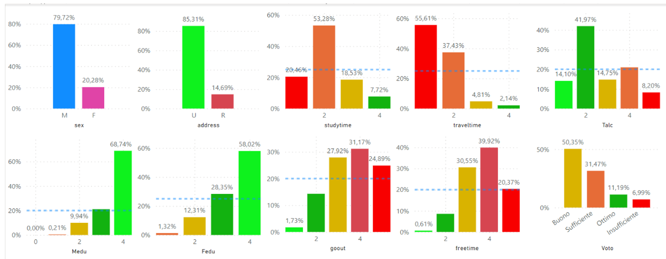
CLUSTERING
CLUSTER 03: " The good boy"
Male, from town, parents of high education, High free time

Slide 37
CLUSTERING
CLUSTER 03: " The good boy"
Male, from town, parents of high education, High free time
This kind of student is blessed with a positive familiar environment it is reflected in a healthy lifestyle and a generally positive academic performance.

Slide 38
CLUSTERING
CLUSTER 03: " The good boy"
Male, from town, parents of high education, High free time
As free time is high and travel time is low it is advised to make sure the potential of this student to be allowed for full development
It is advised to invest in afternoon advanced educational activities.

Slide 39
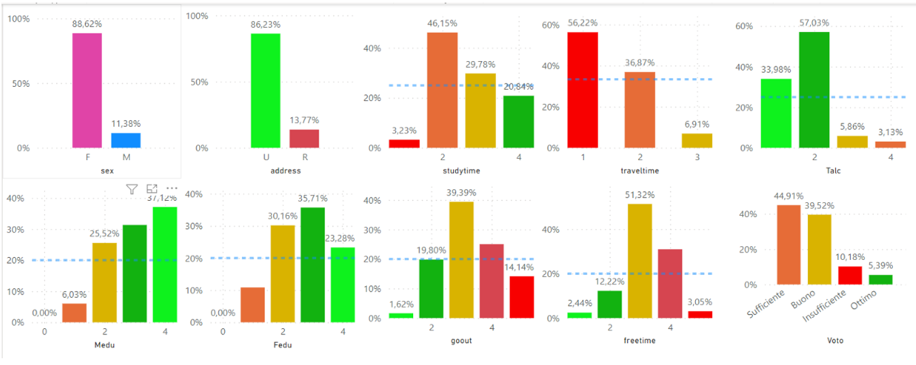
CLUSTERING
CLUSTER 04: " The good girl"
Female, from town, parents of high education, low alcohol consumption

Slide 40
CLUSTERING
CLUSTER 04: " The good girl"
Female, from town, parents of high education, low alcohol consumption
This kind of student is independent, well behaved and with discipline but they display a low level of going out with friends.
It is advised to invest in psychological counseling, as great academic performance could be an effect of unhealthy lifestyles and environments.

Slide 41
FINAL THOUGHTS
With the provided dataset and the used ML methods it was found that while alcohol consumption is linked to low academic performance it does’t appear to be a cause but rather a consequence of other issues.
If correctly and timely addressed at the root, the educator might be able to solve said issues and be a positive leading force in the student growth and development

Slide 42
“Life is 10% what happens to me and 90% of how I react to it.”
Charles Swindoll

Slide 43


